Slide 1
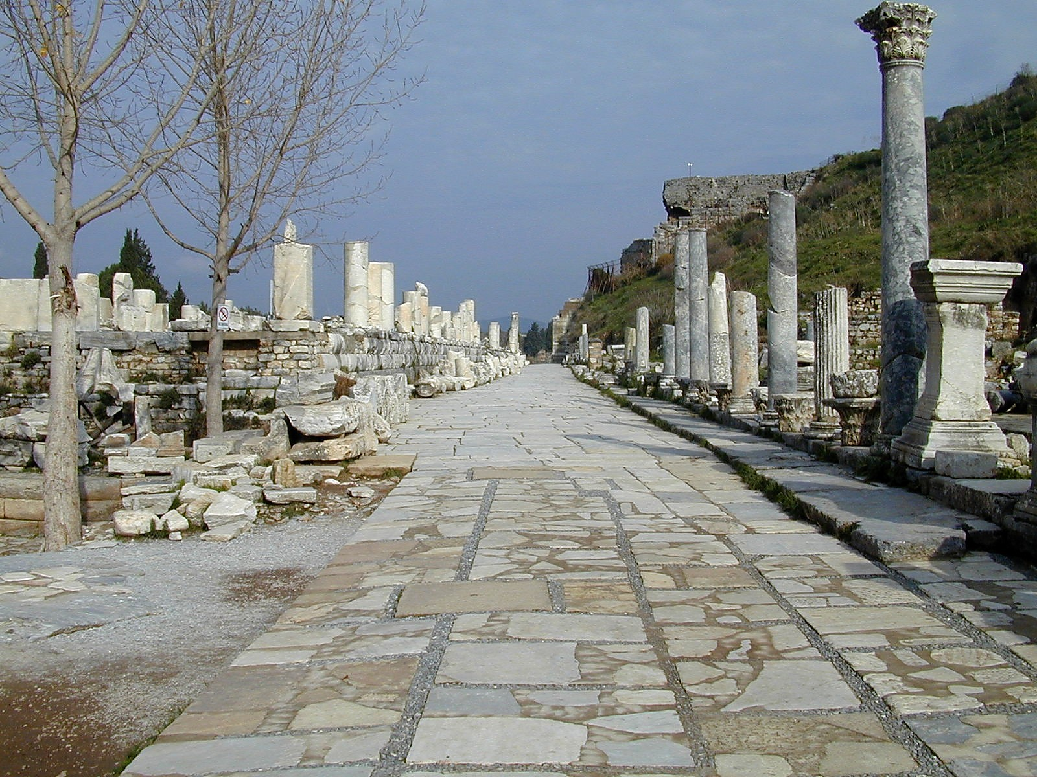
2 Timothy 1.1-12
Dare to Share!
A road in Ephesus. This photo is from the collection "Pictorial Library of Bible Lands, volumes 1-10," © 2006 by Todd Bolen, BiblePlaces.com

Slide 2
2 Timothy 1.1-2: From Paul, an apostle of Christ Jesus by the will of God, to further the promise of life in Christ Jesus, ² to Timothy, my dear child. Grace, mercy, and peace from God the Father and Christ Jesus our Lord!

Slide 3
2 Timothy 1.1-2: From Paul, an apostle of Christ Jesus by the will of God, to further the promise of life in Christ Jesus, ² to Timothy, my dear child. Grace, mercy, and peace from God the Father and Christ Jesus our Lord!

Slide 4
2 Timothy 1.1-2: From Paul, an apostle of Christ Jesus by the will of God, to further the promise of life in Christ Jesus, ² to Timothy, my dear child. Grace, mercy, and peace from God the Father and Christ Jesus our Lord!

Slide 5
2 Timothy 1.1-2: From Paul, an apostle of Christ Jesus by the will of God, to further the promise of life in Christ Jesus, ² to Timothy, my dear child. Grace, mercy, and peace from God the Father and Christ Jesus our Lord!

Slide 6
2 Timothy 1.1-2: From Paul, an apostle of Christ Jesus by the will of God, to further the promise of life in Christ Jesus, ² to Timothy, my dear child. Grace, mercy, and peace from God the Father and Christ Jesus our Lord!

Slide 7
1.3-5: I am thankful to God, whom I have served with a clear conscience as my ancestors did, when I remember you in my prayers as I do constantly night and day. ⁴ As I remember your tears, I long to see you, so that I may be filled with joy. ⁵ I recall your sincere faith that was alive first in your grandmother Lois and in your mother Eunice, and I am sure is in you.

Slide 8
1.3-5: I am thankful to God, whom I have served with a clear conscience as my ancestors did, when I remember you in my prayers as I do constantly night and day. ⁴ As I remember your tears, I long to see you, so that I may be filled with joy. ⁵ I recall your sincere faith that was alive first in your grandmother Lois and in your mother Eunice, and I am sure is in you.

Slide 9
1.3-5: I am thankful to God, whom I have served with a clear conscience as my ancestors did, when I remember you in my prayers as I do constantly night and day. ⁴ As I remember your tears, I long to see you, so that I may be filled with joy. ⁵ I recall your sincere faith that was alive first in your grandmother Lois and in your mother Eunice, and I am sure is in you.

Slide 10
1.3-5: I am thankful to God, whom I have served with a clear conscience as my ancestors did, when I remember you in my prayers as I do constantly night and day. ⁴ As I remember your tears, I long to see you, so that I may be filled with joy. ⁵ I recall your sincere faith that was alive first in your grandmother Lois and in your mother Eunice, and I am sure is in you.

Slide 11
1.3-5: I am thankful to God, whom I have served with a clear conscience as my ancestors did, when I remember you in my prayers as I do constantly night and day. ⁴ As I remember your tears, I long to see you, so that I may be filled with joy. ⁵ I recall your sincere faith that was alive first in your grandmother Lois and in your mother Eunice, and I am sure is in you.

Slide 12
1.3-5: I am thankful to God, whom I have served with a clear conscience as my ancestors did, when I remember you in my prayers as I do constantly night and day. ⁴ As I remember your tears, I long to see you, so that I may be filled with joy. ⁵ I recall your sincere faith that was alive first in your grandmother Lois and in your mother Eunice, and I am sure is in you.

Slide 13
1.6-8: Because of this I remind you to rekindle God's gift that you possess through the laying on of my hands. ⁷ For God did not give us a Spirit of fear but of power and love and self-control. ⁸ So do not be ashamed of the testimony about our Lord or of me, a prisoner for his sake, but by God's power accept your share of suffering for the gospel.

Slide 14
1.6-8: Because of this I remind you to rekindle God's gift that you possess through the laying on of my hands. ⁷ For God did not give us a Spirit of fear but of power and love and self-control. ⁸ So do not be ashamed of the testimony about our Lord or of me, a prisoner for his sake, but by God's power accept your share of suffering for the gospel.

Slide 15
1.6-8: Because of this I remind you to rekindle God's gift that you possess through the laying on of my hands. ⁷ For God did not give us a Spirit of fear but of power and love and self-control. ⁸ So do not be ashamed of the testimony about our Lord or of me, a prisoner for his sake, but by God's power accept your share of suffering for the gospel.

Slide 16
1.6-8: Because of this I remind you to rekindle God's gift that you possess through the laying on of my hands. ⁷ For God did not give us a Spirit of fear but of power and love and self-control. ⁸ So do not be ashamed of the testimony about our Lord or of me, a prisoner for his sake, but by God's power accept your share of suffering for the gospel.

Slide 17
1.9-10: He is the one who saved us and called us with a holy calling, not based on our works but on his own purpose and grace, granted to us in Christ Jesus before time began, ¹⁰ but now made visible through the appearing of our Savior Christ Jesus. He has broken the power of death and brought life and immortality to light through the gospel!

Slide 18
1.9-10: He is the one who saved us and called us with a holy calling, not based on our works but on his own purpose and grace, granted to us in Christ Jesus before time began, ¹⁰ but now made visible through the appearing of our Savior Christ Jesus. He has broken the power of death and brought life and immortality to light through the gospel!

Slide 19
1.9-10: He is the one who saved us and called us with a holy calling, not based on our works but on his own purpose and grace, granted to us in Christ Jesus before time began, ¹⁰ but now made visible through the appearing of our Savior Christ Jesus. He has broken the power of death and brought life and immortality to light through the gospel!

Slide 20
1.9-10: He is the one who saved us and called us with a holy calling, not based on our works but on his own purpose and grace, granted to us in Christ Jesus before time began, ¹⁰ but now made visible through the appearing of our Savior Christ Jesus. He has broken the power of death and brought life and immortality to light through the gospel!

Slide 21
1.9-10: He is the one who saved us and called us with a holy calling, not based on our works but on his own purpose and grace, granted to us in Christ Jesus before time began, ¹⁰ but now made visible through the appearing of our Savior Christ Jesus. He has broken the power of death and brought life and immortality to light through the gospel!

Slide 22
1.11-12: For this gospel I was appointed a preacher and apostle and teacher. ¹² Because of this, in fact, I suffer as I do. But I am not ashamed, because I know the one in whom my faith is set and I am convinced that he is able to protect what has been entrusted to me until that day.

Slide 23
1.11-12: For this gospel I was appointed a preacher and apostle and teacher. ¹² Because of this, in fact, I suffer as I do. But I am not ashamed, because I know the one in whom my faith is set and I am convinced that he is able to protect what has been entrusted to me until that day.

Slide 24
2 Timothy 1.1-12
Dare to Share!
A road in Ephesus. This photo is from the collection "Pictorial Library of Bible Lands, volumes 1-10," © 2006 by Todd Bolen, BiblePlaces.com

